Slide 1

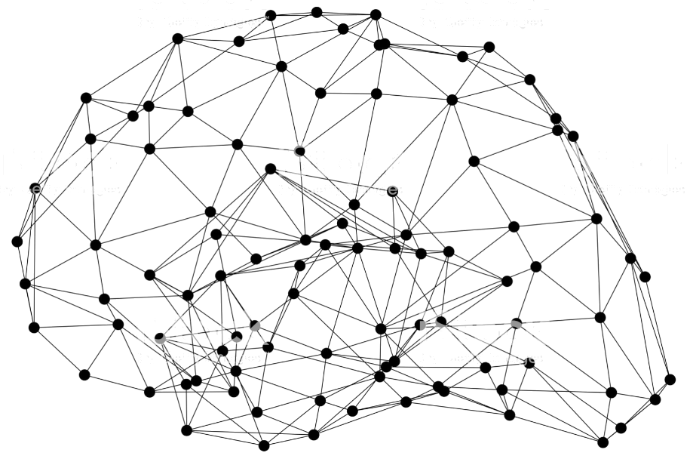
Introduction to GluonCV
Notes:
First call deck for a high level introduction to Apache MXNet.

Slide 2
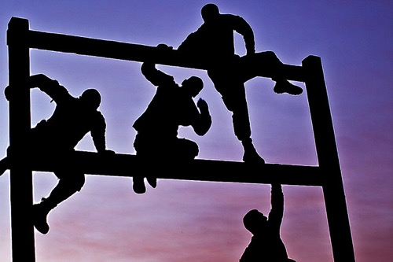
Why GluonCV?
What is the biggest challenge you have ever encountered with deep learning?

Slide 3
Why GluonCV?
What is the biggest challenge you have ever encountered with deep learning?
“reproducing the best claimed results from latest papers”
SOTA
state-of-the-art

Slide 4
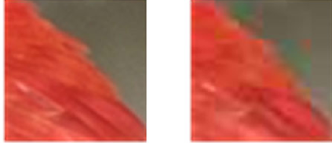
Real-world Stories #1
Back to a period in 2016, the same ImageNet models trained by MXNet achieved on average 1% worse accuracy compared to Torch.
Tried almost everything to debug, even developed a plugin to run Torch code inside MXNet to make it easier to compare results.
=> Transcoding training images using 95 JPEG quality rather than 85 solved the problem.

Slide 5
Real-world Stories #2
Using another open source DL framework: trained model accuracies cannot match previous internal version.
Spent months to figure out why, with no clue.
=> The order of data augmentation is different from previous version.

Slide 6
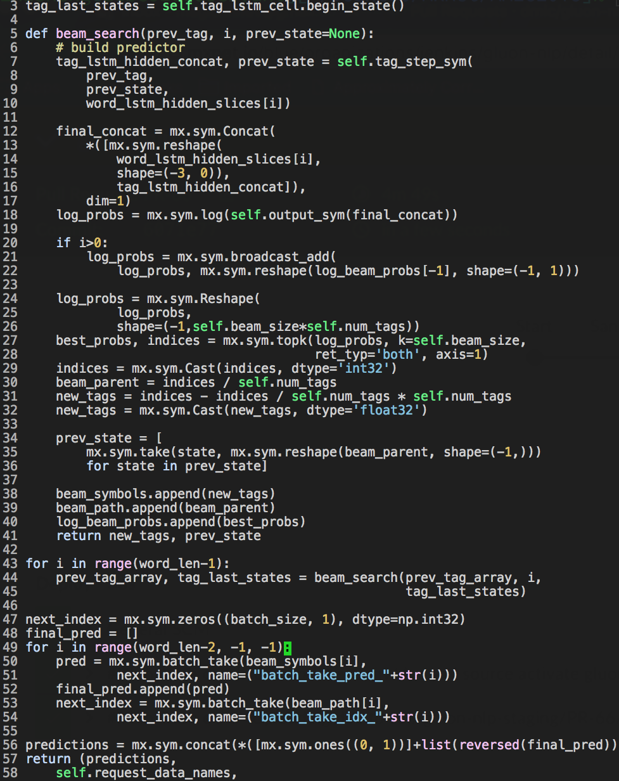
Common myth 1
I will write clean and reusable code when I’m prototyping this time.
Variant:
- I will write clean and reusable code next time.

Slide 7
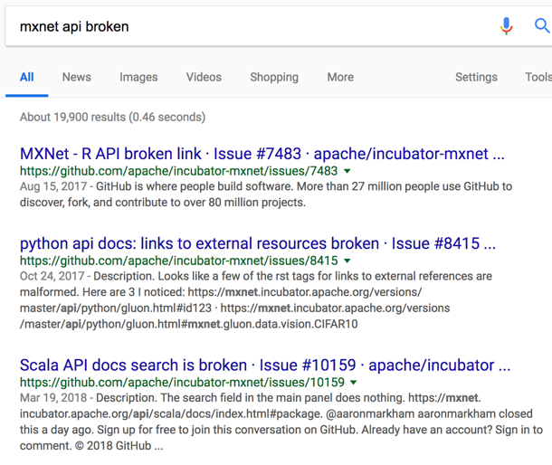
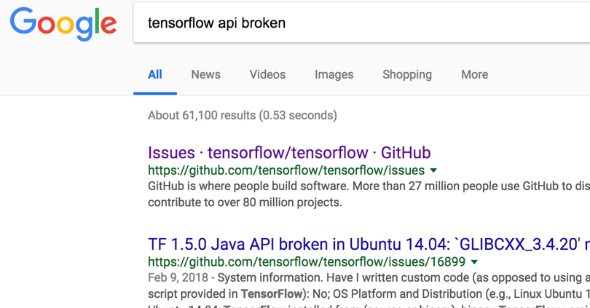
Common myth 2
My code will still run next year.
Sometimes, it’s not our fault.

Slide 8
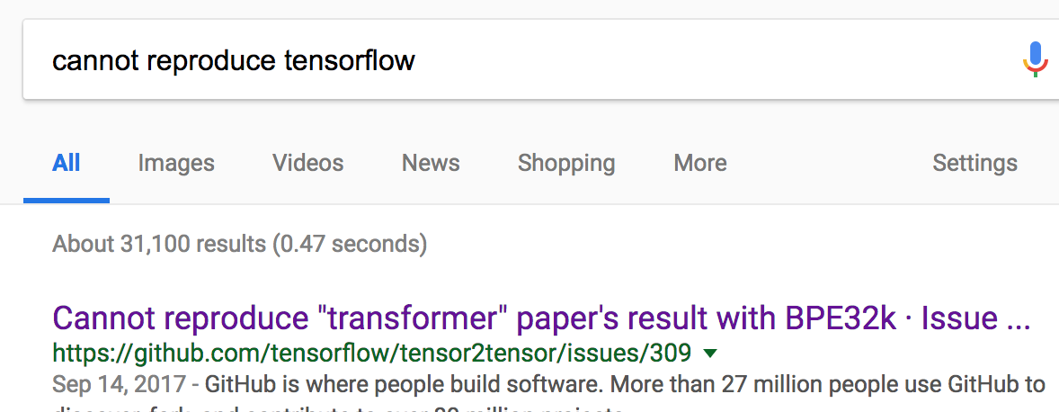
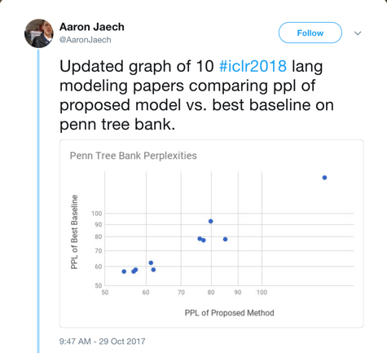
Common myth3
I will finish setting up the baseline model this afternoon.
Though it may not be our fault again.

Slide 9
Starting from scratch can be hard
Even the most talented researchers will get blocked by trivial things.
Experience and instincts can be your enemies in certain circumstances.
Training is time-consuming, initialization and augmentation is randomized, and many implementation details need to be taken care of.
=> Debugging deep learning models is extremely difficult.

Slide 10
CUDA Malloc error
Test Accuracy 0%
Illegal Memory Access Encountered
Loss at Epoch 123: NaN

Slide 11
It’s not easy to embrace open-source implementations
Often the quality of open-source implementations vary.
Languages, code styles, project structures, DL frameworks are mixed.
Personal projects tend to focusing on a specific task with specific datasets. It requires significant engineering efforts to adapt to your use case.
Community projects can be abandoned frequently.

Slide 12
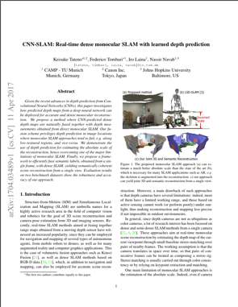
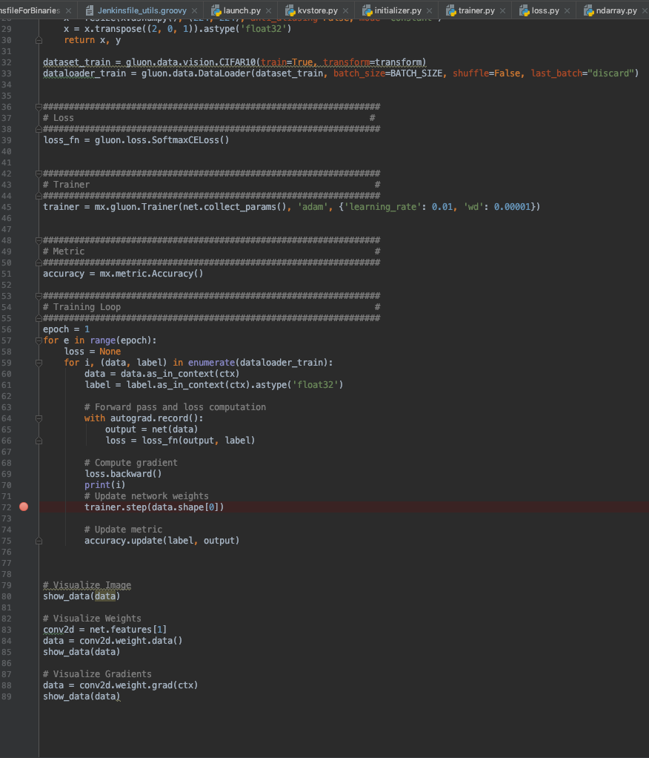
What does GluonCV provide
Reproduction of important papers in recent years
Model zoo with 170+ SOTA pre-trained models
Training scripts (as well as tuned hyper-parameters) to reproduce the results
Full training script + Dataset download script
Logs of training run

Slide 13
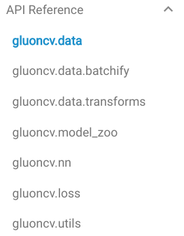
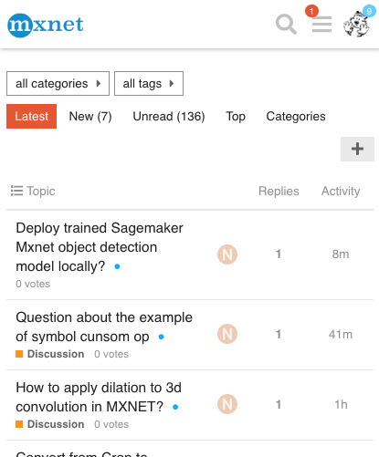
What does GluonCV provide
Considerate APIs and modules that are easy to follow and understand
Avoid re-writing the same utilities again and again
Pre-set data augmentation and transforms, visualization and training utilities
Community support, feel free to ask and discuss
User forum
Github community and open roadmap

Slide 14
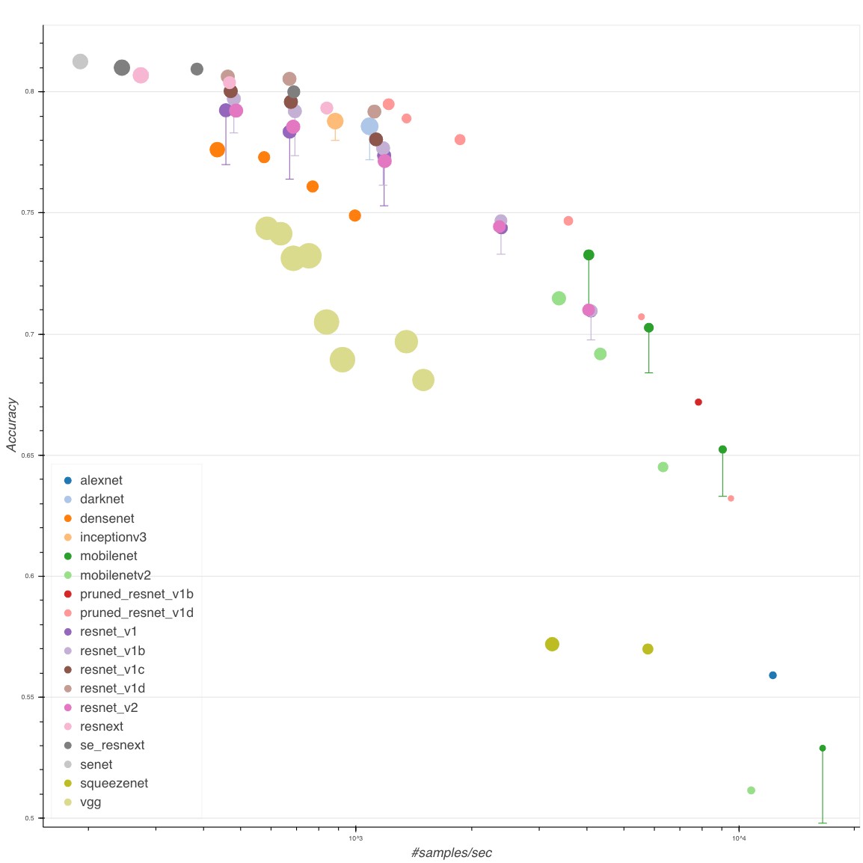
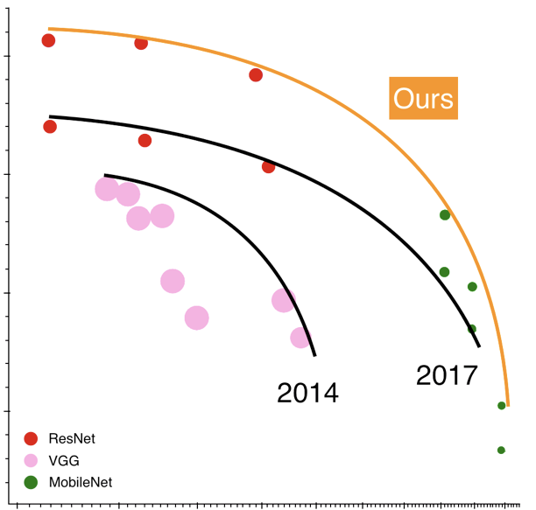

Slide 15
Image Classification
More than 80+ pre-trained ImageNet models(ResNet, MobileNet…)
We achieved the best accuracy using some of the most popular models (e.g., ResNet), compared with other frameworks
Used as backbone in many downstream tasks => better accuracy

Slide 16
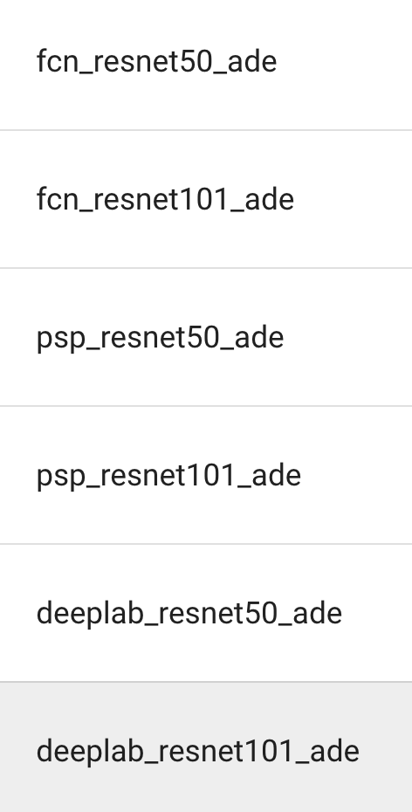
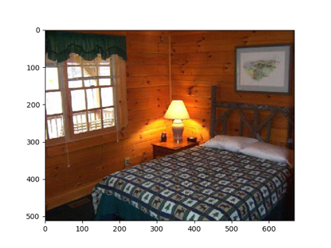
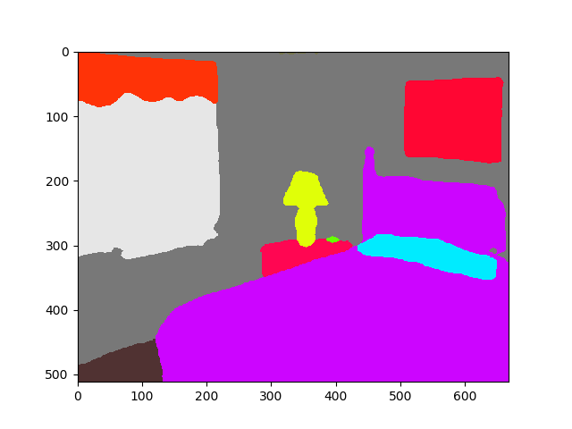
Semantic Segmentation
FCN
PSPNet
Mask-RCNN
DeepLab

Slide 17
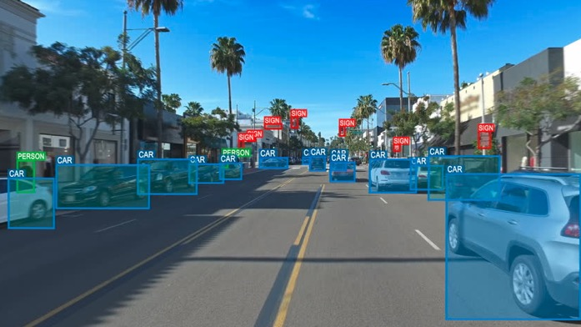
Object Detection
SSD and YOLOv3: fastest solution
Faster-RCNN, RFCN and FPN: slower but more accurate, especially for tiny objects

Slide 18
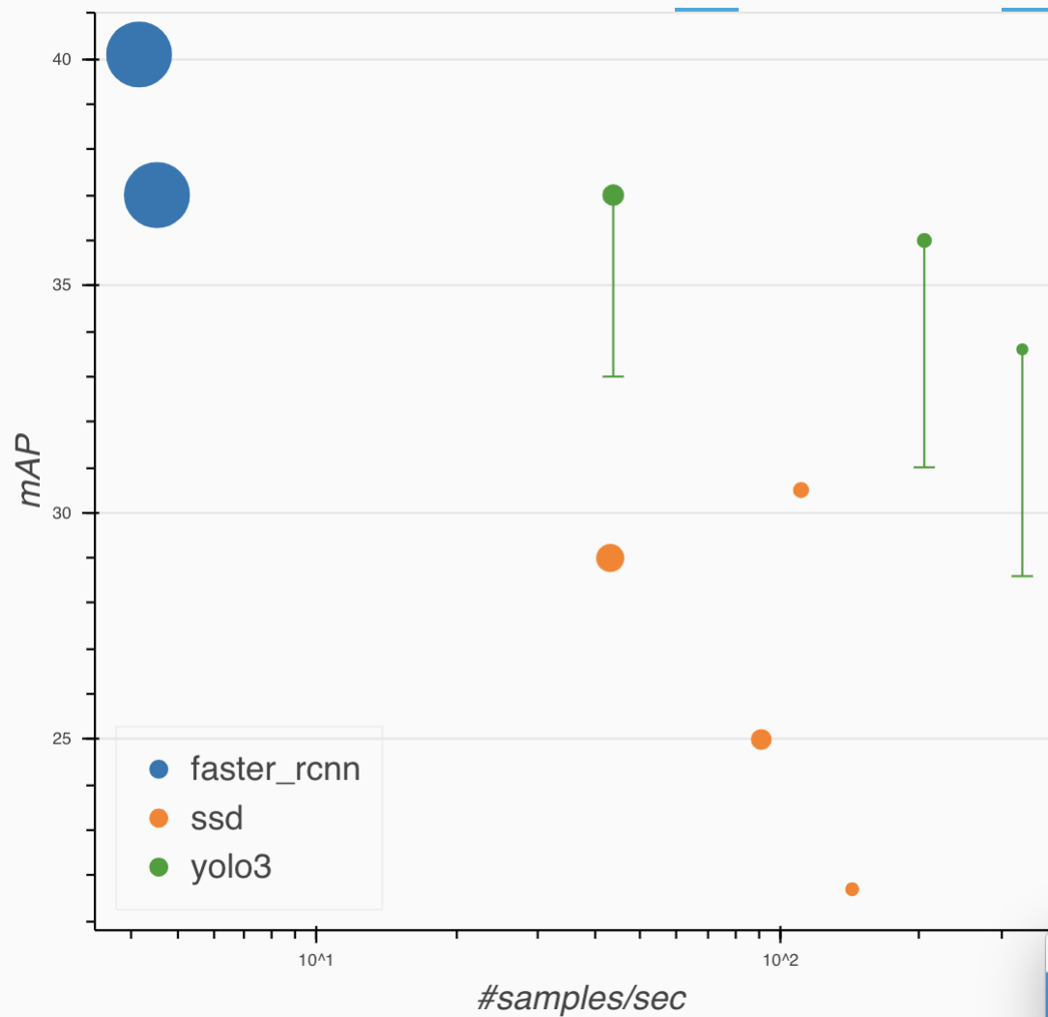
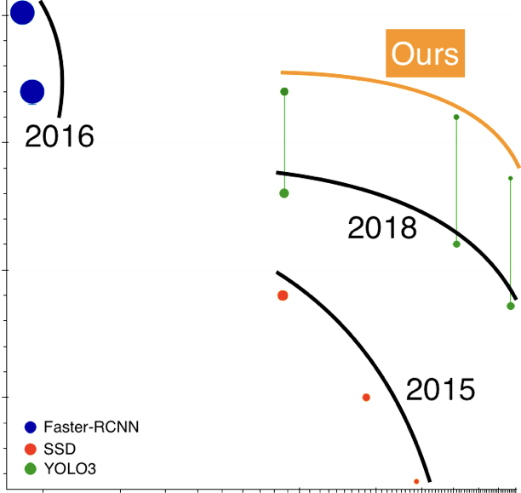

Slide 19
Instance Segmentation
Mask R-CNN

Slide 20
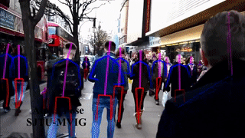
Key Point Estimation
SimplePose
AlphaPose

Slide 21
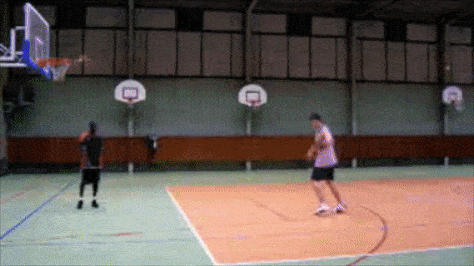
Action Recognition
TSN
I3D

Slide 22
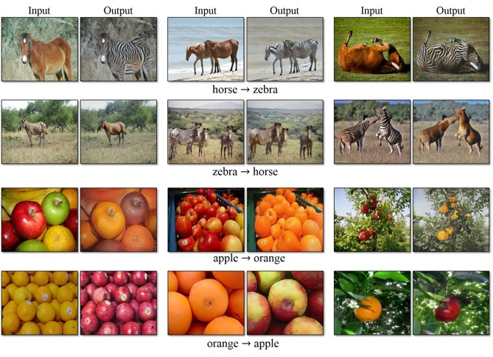
Style Transfer
MSGNet
GANs
CycleGAN
SRGAN
WGAN
Re-identification
Market1501

Slide 23

Like GluonCV? Go build!
https://github.com/dmlc/gluon-cv
https://gluon-cv.mxnet.io

